Slide 1
Workbook People, Culture and Communication
Internal Use Only
April 2017

Slide 2
Disclaimer
The content of this workbook has been produced by KPMG Germany/Deal Advisory on the basis of German accounting standards and/or IFRS, as well as considering KPMG Germany’s firm and country requirements, regulations, processes, policies and best practices. Please check your local accounting and other requirements before applying the content.

Slide 3
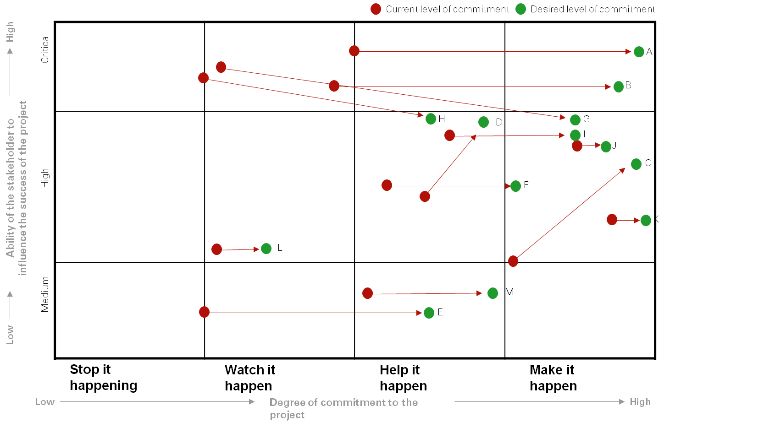
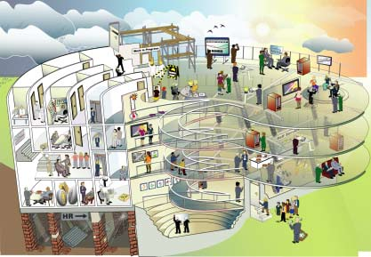
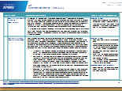
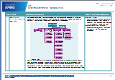
Overview (1/10) – Mission statement
People, Culture and Communication
Mission Statement:
Development of a sustainable people strategy customized to the customer and implementation in the context of transactions
Customer situation
Definition/Methodology/Tools of the basis analysis
Buy Side/Sell Side/JV
Generally relevant for all customer situations in the context of transactions
Definition
Management of all people-relevant challenges in the framework of integrations, separations and JVs
Methodology
HR transaction management
Stakeholder management
Communication
Organization design
Culture
HR department
Tools and templates
Degree of standardization
The approach is standardized
Tools and templates for structuring the output are available
Contents are specifically adapted to the customer

Slide 4
Overview (2/10) – Pitfalls
People, Culture and Communication
No. | Pitfalls/Lessons learned
 | Stakeholders from whom resistance is to be expected must be “caught” early and “aligned”
 | Communication must have a clear responsible person on the customer side who is in the central project team and supports the project strategically with regards to communication. Communication must be proactive and not reactive!
 | The material steps to organization design must be defined and communicated as early as possible to avoid that the process is too drawn out
 | Cultural integration must begin at the management level prior to the closing; therefore the process must be initiated early
 | HR always provides potential synergy – it is only a question of how strictly this is demanded. For this, the integration of the HR functions is decisive
1
2
3
4
5

Slide 5
Overview (3/10) – Core issues
People, Culture and Communication
Core Issue | Specific analysis | Page(s)
How can the most important stakeholders be steered during the transaction? | Overview of the stakeholder groups, sub-categories and individual persons Determination of the desired engagement levels (stakeholder map) Determination of the involvement and communication needs of the stakeholders (stakeholder engagement plan) – if necessary, planning of the individual “respiration” of stakeholders by prescribed person of trust | 13
2. How should the communication be designed in the transaction process? | Development of communication strategy and plan Development of key messages and Q&As Planning and performance of internal and external communication Planning and implementation of the brand communication | 14
How does the future organizational structure look like? | Stipulate clear design criteria Define high-level NewOrg as early as possible and communicate well and understandably for everyone Define clear process for the further design/definition of the individual functions including timeline and formats & instruments, etc. | 15
What role does culture play in the transaction process? | Create understanding of the current culture and define a future target culture on the basis of the overall strategic objective Transform cultural goals to the individual functions and into team/individual goals Offer trainings for the transition with the other corporate culture – for a better understanding in the project and beyond | 16
How is the HR readiness assured as of day 1? What does the future HR organization look like? | Performance of a HR due diligence Performance of FTE analyses Performance of strategic workforce planning (SWP) Development of HR blueprint and target operating model Consultation planning Development of employee-bonding programs Analysis of the recruiting and training needs Comparison/Adjustment of the payroll accounting, remuneration, employer benefits and pension commitments | 17

Slide 6
Overview (4/10) – Placement in the overall integration process – Integration
People, Culture and Communication
Pre-Signing
Pre-Closing
Post-Closing first 100-Days
Beyond the ...deal
Beyond the ...deal
Signing
Completion/Day 1
100 Days
Objective:
Prepare Signing communication, understand essential HR and cultural issues, develop blueprint of future organization
Plan, analyze and design:
HR Due Diligence or HR standalone/transformation check
Stakeholder analysis
Communication planning
Signing communication
Organization blueprint & high level TOM^{(a)}
Identification of key people and retention management approach
Outside-in cultural analysis
Objective:
Develop Day 1 communication, finalize TOM structure, define clear roles and responsibilities, develop to-be culture, define HR structure and processes
Develop and finalize:
Day 1 communication & event
“Take Control“ as of day of closing
Sign-off of HR interim and target operating model incl. make or buy decision
Review of employer branding strategy – if necessary
Amendment of remuneration system incl. pensions – where necessary
Implementation of retention measures
Definition of roles for tier 1-3
Synergy leverage assessment
Objective:
Implement of to-be operating model, integrate systems and processes, drive ongoing communication & cultural post-merger integration
Implement:
“Names to boxes” process & transfer of people
Realization of quick wins
Review of financial business plan (bottom-up)
Robust benefit & synergy monitoring incl. project governance
TOM validation and review
HR process validation and review
Cultural fit assessment
Implementation of remuneration system incl. pensions
Employer brand “temperature check”
Objective:
Assess integration outcome and conclusion, identify additional benefit potential
Monitor:
Realization of synergies
Sustainability assessment to increase benefits and leverage synergy effects
Strategic workforce planning
Integration success monitoring/ review of KPI’S
Derivation of lessons learned
Set up of “second wave of integration” if necessary
Evaluation of cultural integration
Note: (a) TOM = Target Operating Model

Slide 7
Overview (5/10) – Placement in the overall integration process – Separation
People, Culture and Communication
Pre-Signing
Pre-Closing
Post-Closing first 100-Days
Beyond the ...deal
Beyond the ...deal
Signing
Completion/Day 1
100 Days
Objective:
Prepare Signing communication, understand essential HR and cultural issues, develop carve-out blueprint of future organization
Plan, analyze and design:
HR standalone/carve-out transformation check
Stakeholder analysis
Communication planning
Signing communication
Organization blueprint & high level TOM^{(a)}
Identification of key people and retention management approach
Objective:
Develop Day 1 communication, establish people transfer matrix, ensure timely employee benefits replication and payroll setup, define to-be organizational structure incl. new roles and responsibilities – if needed
Develop and finalize:
Day 1 communication & event
People transfer matrix incl. local labor law requirements
Replication of employee benefits, e.g. insurances, pension plans
Payroll setup, e.g. TSA, outsource or timely setup at target
Process and function consolidation check
Review of employer branding strategy – if necessary
Implementation of retention measures
Objective:
Ensure business as usual and increase efficiencies due to process harmonization, distribute regular communication
Implement:
Implementation of people transfer matrix
Realization of quick wins
Optimization of organization design post-carve-out, e.g. synergy leverage
Employee Engagement Index (EEI) assessment post-closing
Objective:
Assess separation/carve-out benefits, identify additional benefit potential
Monitor:
Realization of cost savings
Separation success monitoring/ review of KPI’s
Strategic workforce planning
Derivation of lessons learned
Note: (a) TOM = Target Operating Model

Slide 8
Overview (6/10) – Stakeholder management approach
People, Culture and Communication
Details on Methodology/Approach
1
2
3
Initial basis understanding
…development
Coordination & approval
Further integration/Separation/JV approach
Initial basis understanding
…development (pre-closing)
Coordination & approval (pre-closing)
1
2
3
Approach:
Analyze stakeholders for importance and attitude to the deal
Identify critical stakeholders and set up corresponding measures for positive influencing
Proactively involve positively minded stakeholders
Approach:
Set up stakeholder management program (from individual to group measures)
Detail and plan stakeholder management measures
Permanent accompanying stakeholder management in a coaching function along with project management
Approach:
Implementation of stakeholder management measures
Update of the stakeholder analysis
Process steps

Slide 9
Overview (7/10) – Communication approach
People, Culture and Communication
Details on Methodology/Approach
1
2
3
Initial basis understanding
…development
Coordination & approval
Further integration/Separation/JV approach
Initial basis understanding
…development (pre-closing)
Coordination & approval (pre-closing)
1
2
3
Approach:
Understand the communication needs from the project for internal and external communication
Determine customers’ communication forms and formats
Approach:
Set up communication strategy with communication responsibilities, communication channels, communication cascade and approval processes for communication content
Define the corresponding key milestones from the project plan for internal and external communication according to the communication plan
Approach:
Define and coordinate key messages
Design, set up and roll out communication measures for internal and external communication (e.g. communication package, newsletter, road show, day-1 event, management meeting, customer letter)
Process steps

Slide 10
Overview (8/10) – Organization design approach
People, Culture and Communication
Details on Methodology/Approach
1
2
3
Initial basis understanding
…development
Coordination & approval
Further integration/Separation/JV approach
Initial basis understanding
…development (pre-closing)
Coordination & approval (pre-closing)
1
2
3
Approach:
Determine and analyze as-is organization
Determine & communicate organization design approach
Approach:
Define key design principles for NewOrg
Determine blueprint process
Prepare process & instruments/formats for the definition of TOM
Determine and coordinate high-level overall TOM
Nominate and communicate tier 1-3 of the TOM
Perform management assessments
Approach:
Determine “names to boxes“ process for tier 4 and below
Documentation of the NewOrg in the relevant systems
Transformation workshops & teambuilding
Process steps

Slide 11
Overview (9/10) – Culture approach (Integration & JV only)
People, Culture and Communication
Details on Methodology/Approach
1
2
3
Initial basis understanding
…development
Coordination & approval
Further integration/Separation/JV approach
Initial basis understanding
…development (pre-closing)
Coordination & approval (pre-closing)
1
2
3
Approach:
Outside-in analysis of culture and determine gaps between the individual corporate cultures
Identification of primary “cultural hot spots‘ and derivation of “mitigation measures”
Approach:
Key-player interviews on both sides for understanding of current culture
Broad-stroke query of current culture with online-based questionnaire to major target groups
Performance of a cultural analysis by means of the data collected through key-player interviews & online questionnaire
Approach:
Definition of the cultural framework and breakdown of the cultural objective for key functions (e.g. Sales, R&D)
Definition of cultural measures for an optimal integration and accompaniment of implementation
If necessary, repeated collecting of the culture for review
Process steps

Slide 12
Overview (10/10) – HR approach
People, Culture and Communication
Details on Methodology/Approach
1
2
3
Initial basis understanding
…development
Coordination & approval
Further integration/Separation/JV approach
Initial basis understanding
…development (pre-closing)
Coordination & approval (pre-closing)
1
2
3
Approach:
HR due diligence
Analysis of HR as-is organization
Benchmarking of HR key data (e.g. support ratio, payroll sourcing, process costs e.g. recruiting)
Standalone readiness check
Approach:
Definition of HR IOM^{(a)} and TOM^{(b)}
Retention concept and measures definition/ implementation
Concept for adaptation/optimization of remuneration and incentives
Assessment of quick wins/synergy
Assurance of day-1 readiness (e.g. credit cards, leased cars, contract management, etc.)
Approach:
Validation of synergies and definition of implementation measures including timeline / implementation plan
Process optimization or Insourcing / outsourcing of processes
Alignment of issues (e.g. remuneration, incentives, old-age pension, performance appraisals, commitment on objectives, etc.)
Determine and set up employer branding strategy
Process steps
Note: (a) IOM = Interim Operating Model; (b) TOM = Target Operating Model

Slide 13
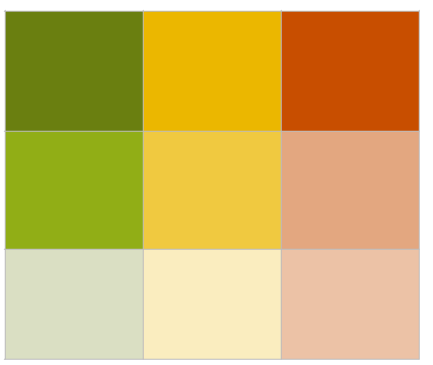
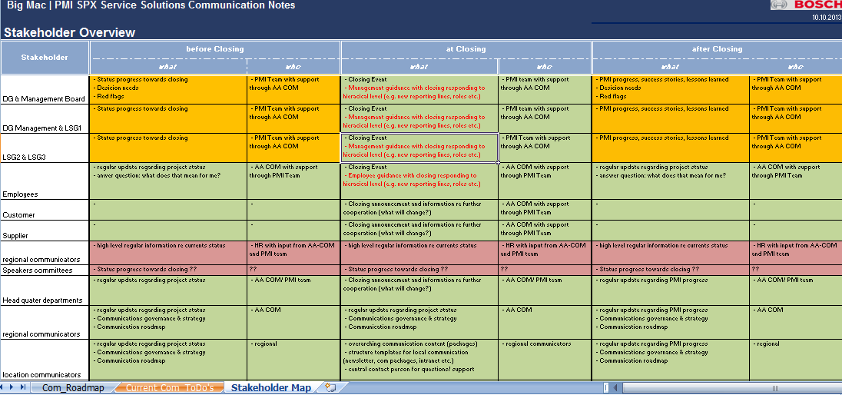
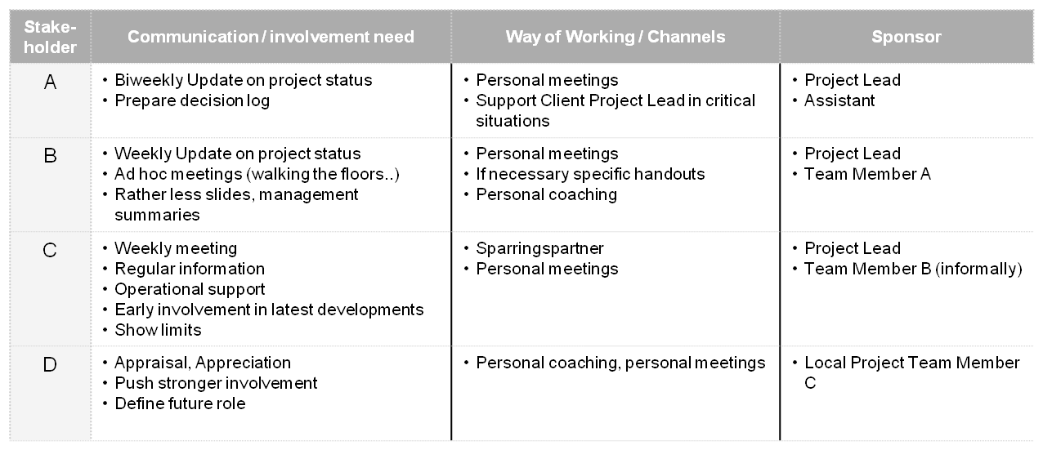
1. How can the most important stakeholders be steered during the transaction? (Project example)
People, Culture and Communication
Core Statements:
Knowing stakeholders who are critical as well as those with a positive attitude is a basic prerequisite
Then it is a matter of influencing critical stakeholders positively with the aid of the stakeholders who support the transaction and to establish the necessary measures to do so
Should stakeholders have too negative attitudes for driving the program, it should also be considered to transfer them to not endanger the target achievement
A regular stakeholder analysis assures that the important core persons actively drive the transaction
high
Potential effect on the success of the program
medium
Example
Example
low
negative
neutral
positive
Attitude of stakeholder regarding the program
Example

Slide 14
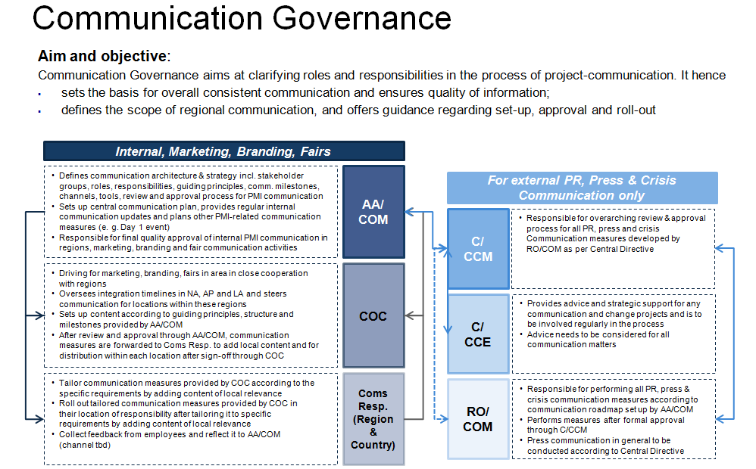
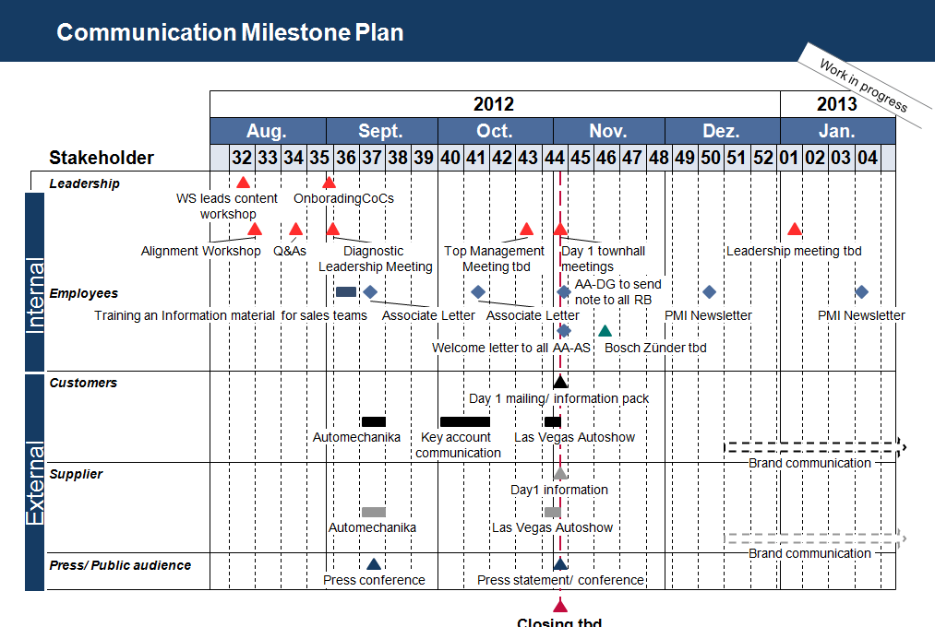
2. How should the communication be designed in the transaction process? (Project example)
People, Culture and Communication
Core Statements:
The communication strategy defines
To whom and through which channels/media communication takes place
Who is responsible for what communication
Objective is that through the communication all affected persons will be “supplied” with key messages that are adapted to the specific target group in a way that essential information / communication needs are covered
The communication planning assures that the primary strategic project milestones are optimally accompanied by communication
Aug.
Sept.
Oct.
Nov.
Dec.
Jan.
Example
Example

Slide 15
3. How does the future organizational structure look like? (Project example)
People, Culture and Communication
Core Statements:
The new structural organization of the NewOrg must be clearly defined (with regard to content (who are the deciders, who gives the final release) and time)
In addition, a sensitive and parallel functioning communication must be assured
Example

Slide 16
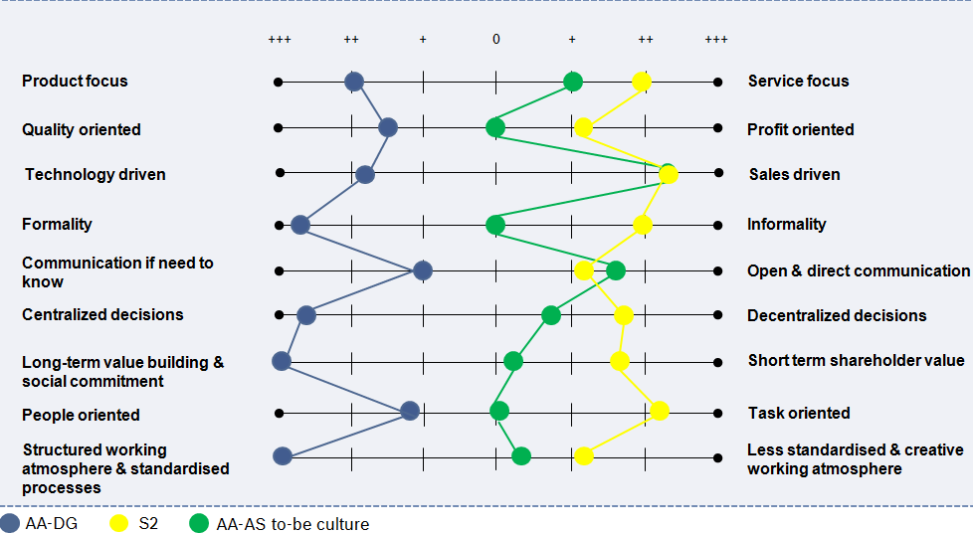
4. What role does culture play in the transaction process? (Project example)
People, Culture and Communication
Core Statements:
Knowing the cultural gaps between two companies and having a clear target culture in mind communicates foothold and safety
A well-founded analysis including managers & employees increases the acceptance
Example

Slide 17
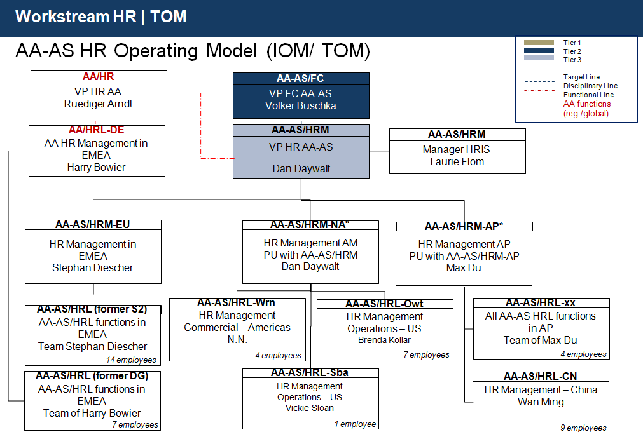
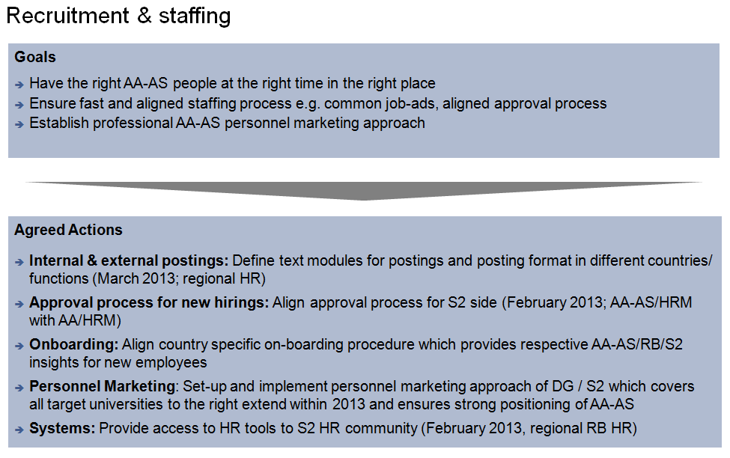
5. How is the HR readiness assured as of day 1? What does the future HR organization look like? (Project example)
People, Culture and Communication
Core Statements:
The HR TOM must be defined early because HR is a supporting function in the integration / separation process and responsibilities and future roles must be clarified
For all HR core processes the decision must be made whether it is relevant for “day-1 readiness“ or not and whether it must be aligned in the short, middle or long term
(Reference to Target Operating Model and Take Control work modules)
Example
Example

Slide 18
© 2017 KPMG International Cooperative (“KPMG International”). KPMG International provides no client services and is a Swiss entity with which the independent member firms of the KPMG network are affiliated.

